Slide 1


Tech Saksham
Capstone Project Report
CREDIT CARD FRAUD DETECTION
“ Builders
Engineering college"
Trainer: K.Vigneshwaran
Master Trainer: Raja
NM ID
au730321114057
NAME
J.VASHEKA SHREE

Slide 2
ABSTRACT
Credit card fraud detection is presently the most frequently occurring problem in the present world. This is due to the rise in both online transactions and e-commerce platforms. Credit card fraud generally happens when the card was stolen for any of the unauthorized purposes or even when the fraudster uses the credit card information for his use. In the present world, we are facing a lot of credit card problems. To detect the fraudulent activities the credit card fraud detection system was introduced.
This project aims to focus mainly on machine learning algorithms. The algorithms used are random forest algorithm and the Adaboost algorithm. The results of the two algorithms are based on accuracy, precision, recall, and F1-score. The ROC curve is plotted based on the confusion matrix. The Random Forest and the Adaboost algorithms are compared and the algorithm that has the greatest accuracy, precision, recall, and F1-score is considered as the best algorithm that is used to detect the fraud.

Slide 3

Contents
Introduction
Literature survey Methodology
Result Conclusion Scope
Links

Slide 4
Introduction
Credit card generally refers to a card that is assigned to the customer (cardholder), usually allowing them to purchase goods and services within credit limit or withdraw cash in advance. Credit card provides the cardholder an advantage of the time, i.e., it provides time for their customers to repay later in a prescribed time, by carrying it to the next billing cycle. Credit card frauds are easy targets. Without any risks, a significant amount can be withdrawn without the owner’s knowledge, in a short period. Fraudsters always try to make every fraudulent transaction legitimate, which makes fraud detection very challenging and difficult task to detect. In 2017, there were 1,579 data breaches and nearly 179 million records among which Credit card frauds were the most common form with 133,015 reports, then employment or tax-related frauds with 82,051 reports, phone frauds with 55,045 reports followed by bank frauds with 50,517 reports from the statics released by FTC.

Slide 5
Literature survey
Multiple Supervised and Semi-Supervised machine learning techniques are used for fraud detection [8], but we aim is to overcome three main challenges with card frauds related dataset i.e., strong class imbalance, the inclusion of labeled and unlabeled samples, and to increase the ability to process a large number of transactions.
Different Supervised machine learning algorithms [3] like Decision Trees, Naive Bayes Classification, Least Squares Regression, Logistic Regression and SVM are used to detect fraudulent transactions in real-time datasets. Two methods under random forests [6] are used to train the behavioural features of normal and abnormal transactions.
They are Random-tree-based random forest and CART-based. Even though random forest obtains good results on small set

Slide 6
Methodology
This chapter discusses the methodology adopted in this study to classify the non-fraudulent transactions from the fraudulent transactions. Figure 1 shows the steps used in this work. However, before we discuss the different steps of the methodology used in this work, we first discussed the dataset.

Slide 7
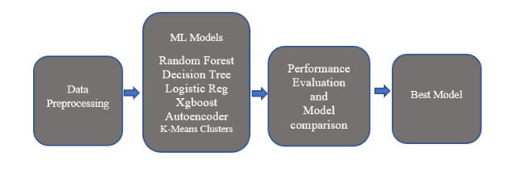

Slide 8
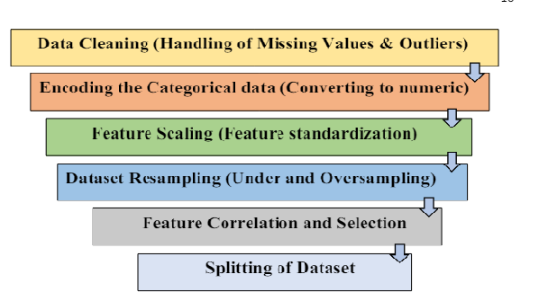

Slide 9
Result
The technology change influenced several improvements. We are talking about online transactions done through credit cards, which leads to credit card frauds, and this study is about improving machine learning algorithms for fraud detection. In this study, we put forth fraud detection methods based on supervised learning such as Random Forest, Decision Tree, Xgboost, and logistic regression, unsupervised learning such as K-means clusters, and one deep learning algorithm known as Auto encoder Neural Network. We compared all the algorithms with different datasets by first using the original dataset itself; we then use resampling techniques such as under sampling and oversampling because our dataset is highly imbalanced. Finally, we concluded that Random Forest would be the perfect fit for our model. It can be inferred that oversampling works better because the smaller number of observations helps in training our model efficiently. Oversampling will be an ideal sampling technique in the real-world scenario as the information containing a pattern is not lost

Slide 10
Scope
Based on the conclusion we have above, we can further improve our approach in this study. Future work can be done on this topic: The current study agreed with the result of the oversampling dataset, which duplicates. Instead of using this oversampling method that duplicates, we can use another sampling technique called interpolation, where redundant observations are not added to our dataset.

